Slide 1

Predicting Heart Disease (before it’s too late)
Group 14

Slide 2


Agenda
Introduction
Data Exploration
Data Visualization
Machine Learning Model Results and Analysis
Findings
Recommendation and Future Outlook

Slide 3




Introduction
We focused on accurately predicting the chances of Cardiac Heart Disease based on various demographic and pre-existing health factors.
Heart disease is essentially the primary cause of death worldwide. Having a working predictive model to get accurate and reliable predictions would be excellent for medical professionals to diagnose early for patients to make positive life choices and for policy makers to enact social policies.
We chose a dataset that was large enough to produce an accurate prediction. This dataset has a pool of 4200 participants of both genders, age, and various lifestyle characteristics, such as diabetes, cholesterol, hypertension, etc.

Slide 4

Data Exploration
When we explored the data we were looking to understand the breakdown of the dataset- inputs and outputs- and what the relationship between these characters meant.
Our dataset was extensive, totaling roughly 4200 participants that were followed over ten years to monitor CHD development.
Potential predictive variables were: sex, age, education, smoker/non-smoker,(cigarettes per day), diabetic/non-diabetic among other factors. Due to length of data collection there may have been some data loss that may have had an impact on prediction accuracy. We removed some factors that were deemed irrelevant to the analysis (i.e., education)

Slide 5
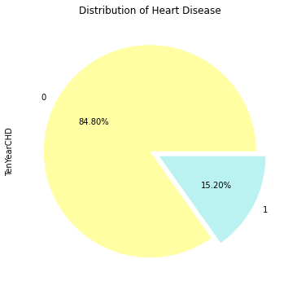
Data Exploration (contd..)
The breakdown of who developed CHD was 644 participants, compared to 3594 who didn’t.

Slide 6
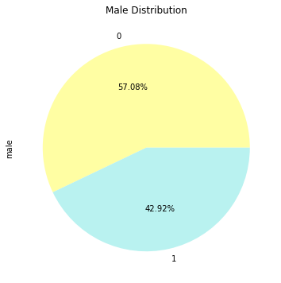
Data Exploration (contd..)
Breaking down the data by male and female - 57% male, 43% female

Slide 7
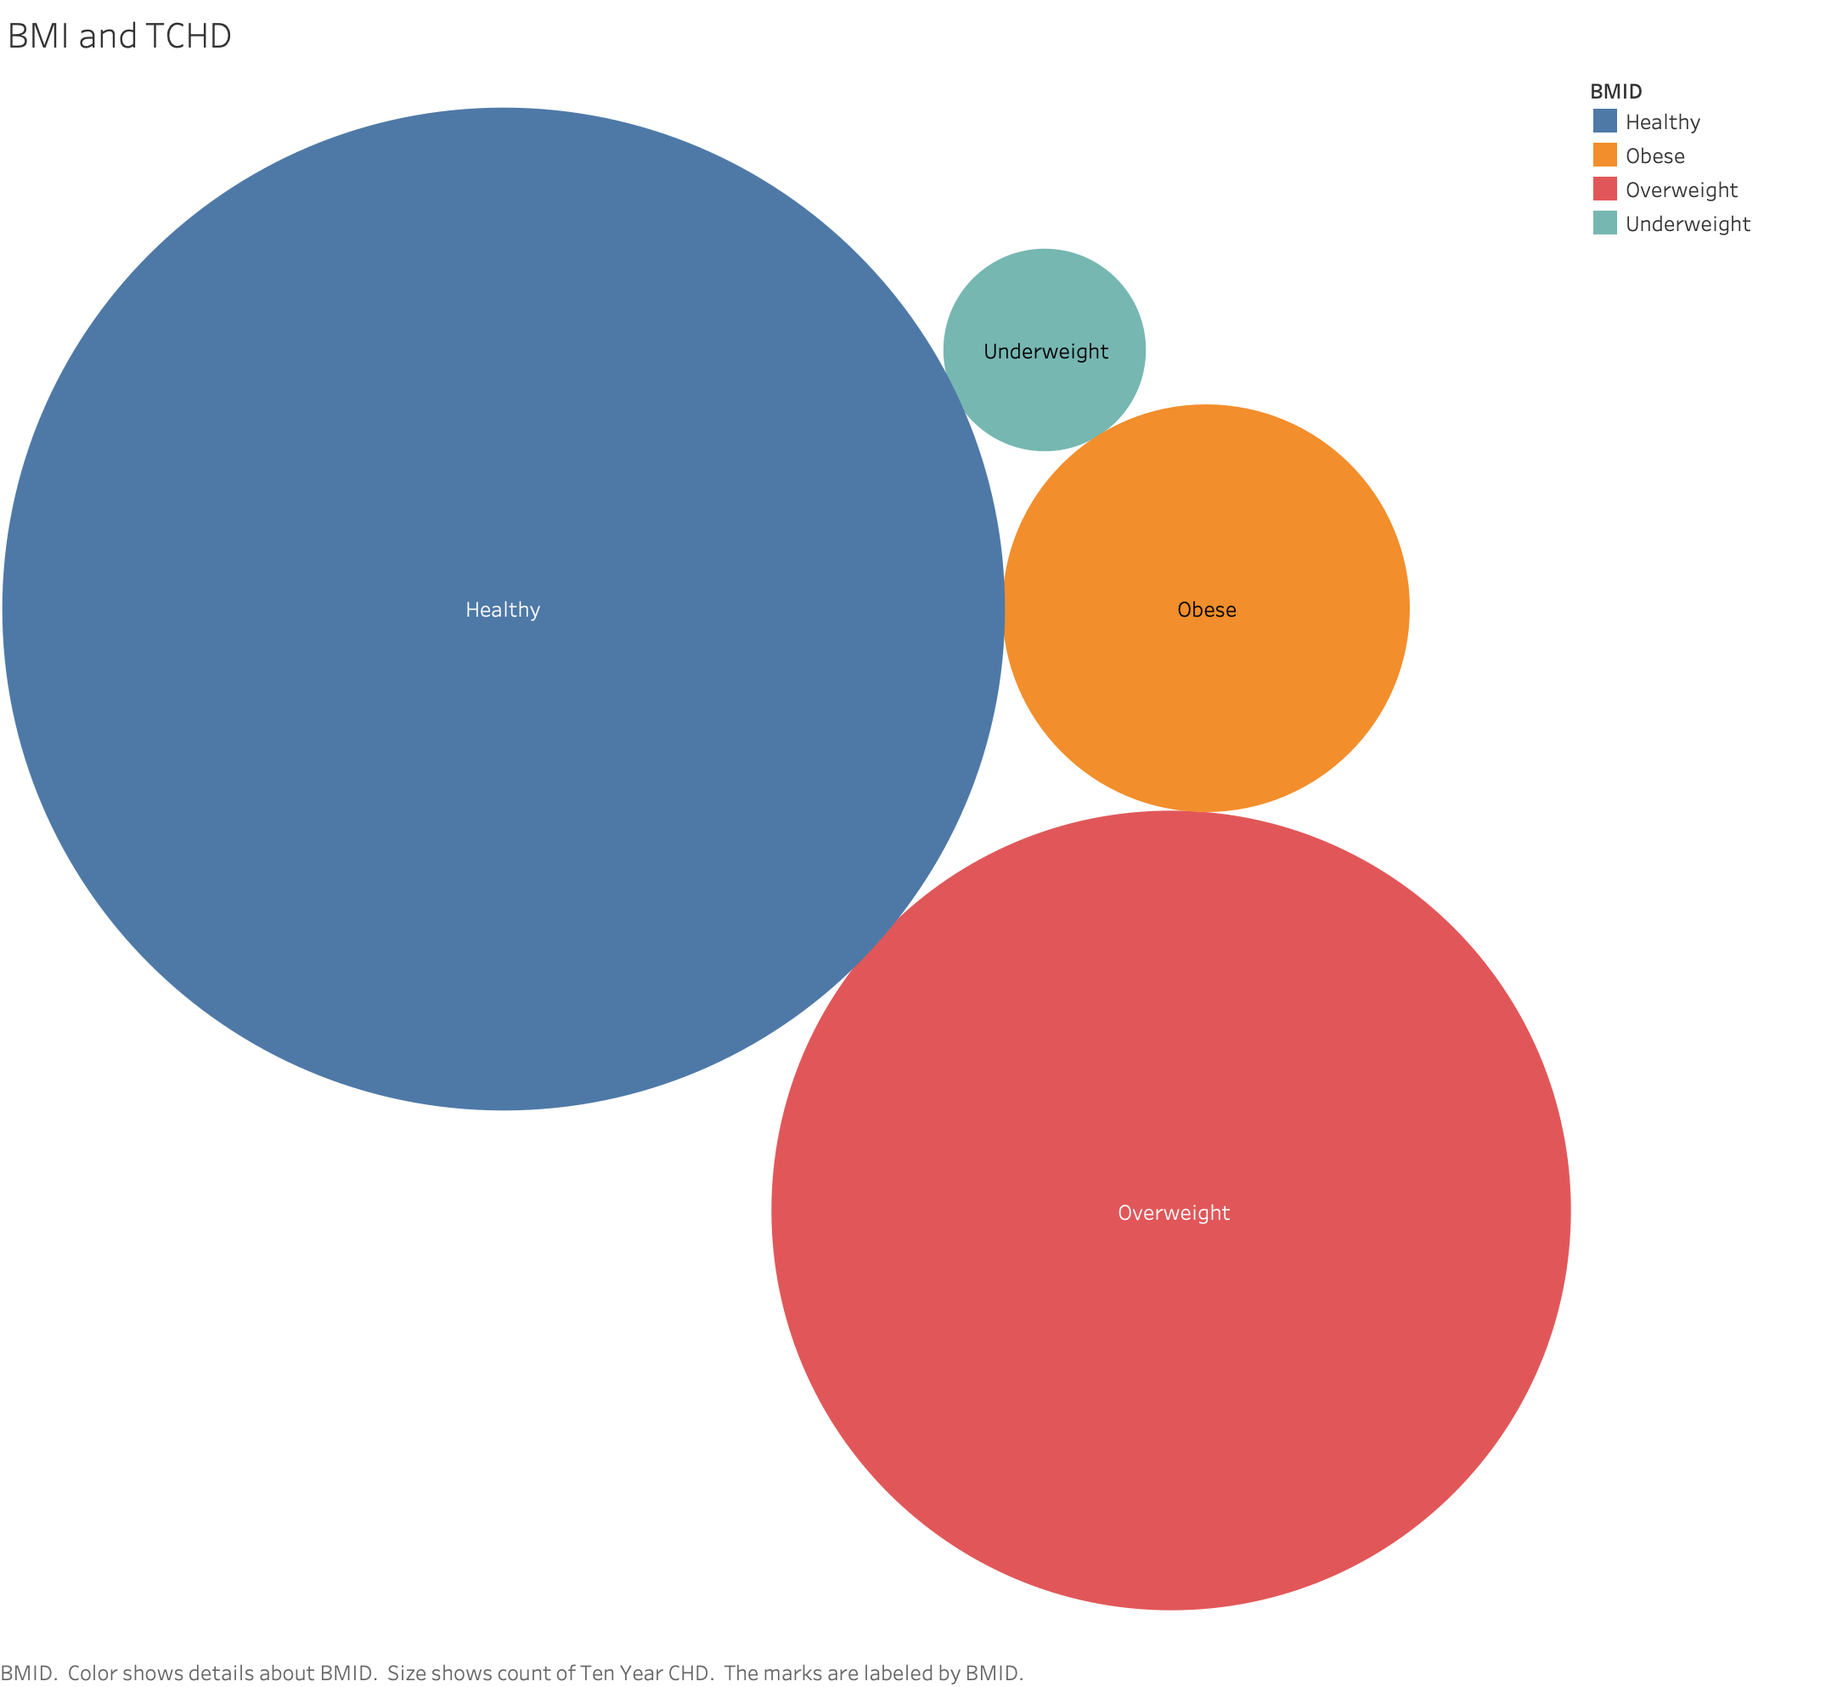
Data Exploration (contd..)
We found that the majority of people who developed CHD after ten years were within a healthy weight range, which goes against our ideas that overweight or obesity contributes more to heart disease

Slide 8
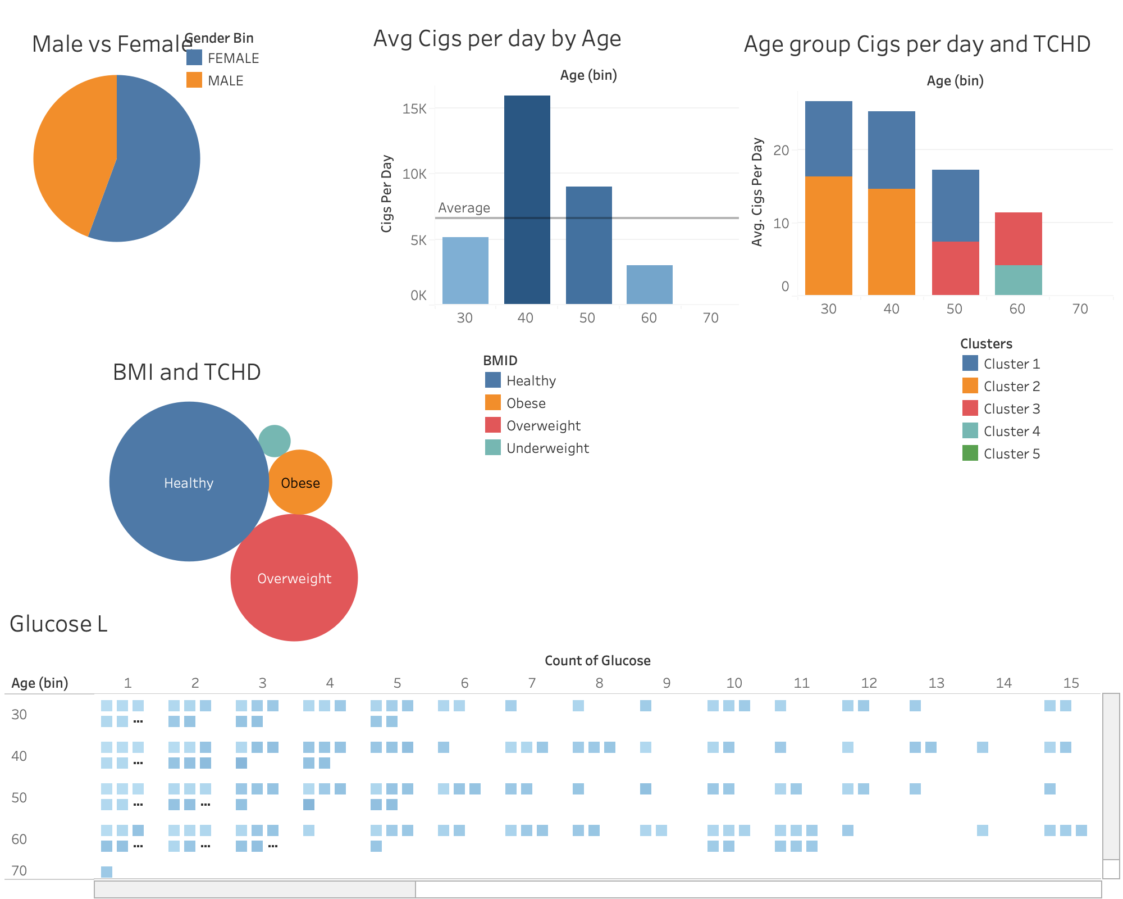
Exploratory Dashboard

Slide 9
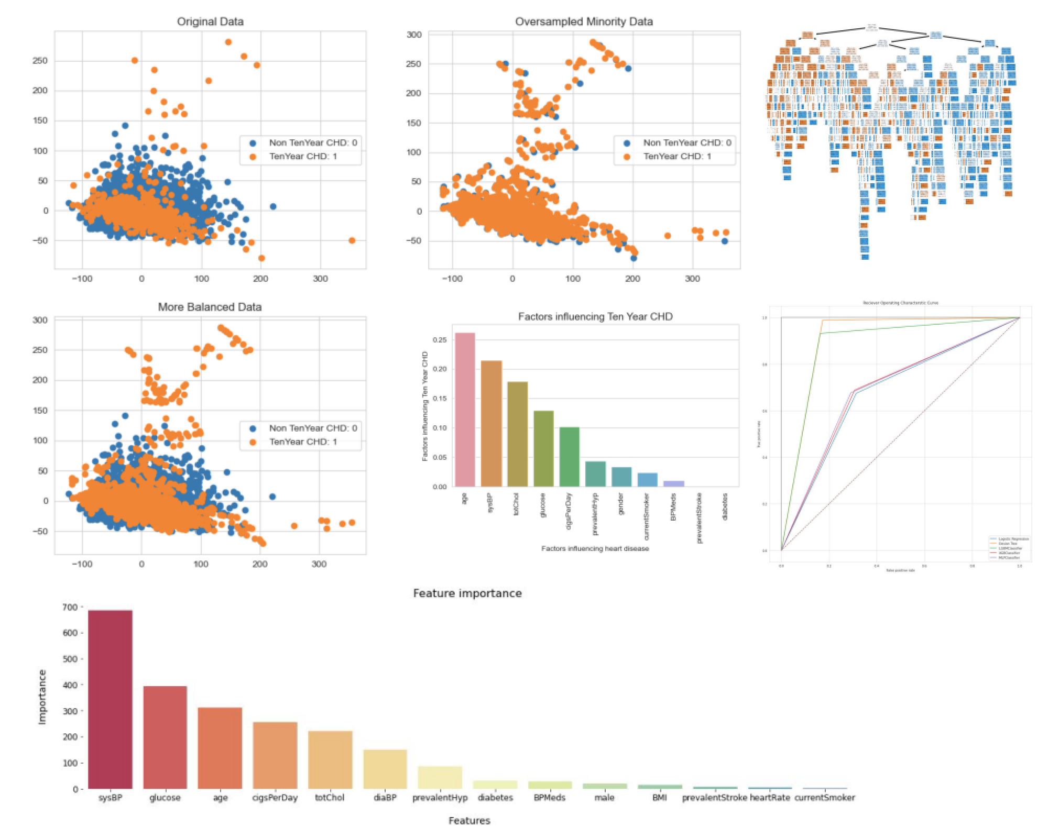
Analysis Dashboard

Slide 10
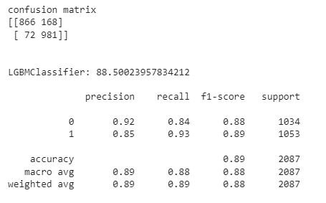
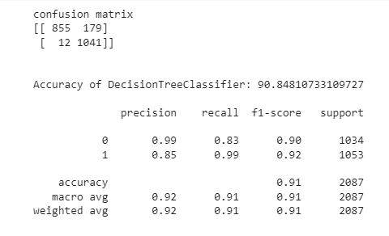
Results and Analysis
Logistic Regression
SVM and Light GBM
Decision Tree
In our analysis we created a logistic regression model to predict one of two outcomes = whether each participant would develop CHD or not
But due to the nature of the data and possible outliers the accuracy for prediction was very low.
Further analysis improved the model to 66% accuracy.
Using these two methods we improved the model significantly.
We were able to achieve 84% accuracy under SVM and 89% accuracy under Light GBM.
Further exploration into other models to improve the model resulted in a slight increase from 89% to 91%

Slide 11
Findings
Age and Blood Pressure had significant impact on future coronary heart disease. High glucose followed next.
Positive correlation between cigs per day and chances of developing coronary heart disease. On an average 30 to 50 age range had the highest cigs consumption per day and had coronary heart disease.
Education had limited or no impact on the model prediction.
Outliers and imbalanced data affected the accuracy.

Slide 12

Recommendation and Future Outlook
Robustness of the model can be improved by adding relevant variables such as frequency of exercise, types of food consumption etc. and additional data points.
Experiment and utilize additional machine learning models to improve accuracy.
We can use the same dataset to predict other health conditions such as Stroke, Diabetes by changing the dependent and independent variables.

Slide 13



Team
Amber
Halengo
Jared
Josna
Mahbub

Slide 14


Thank You

Slide 15
Questions and Suggestions?

